Slide 1
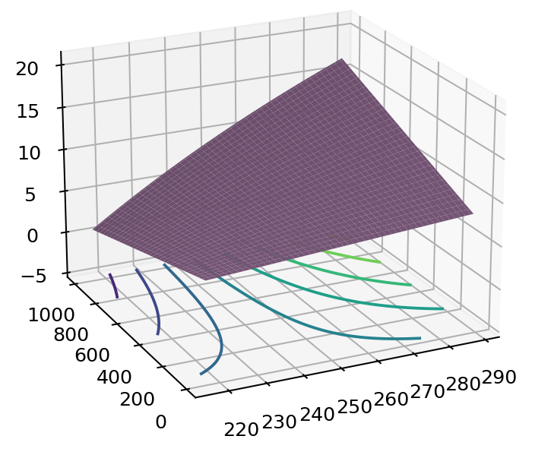


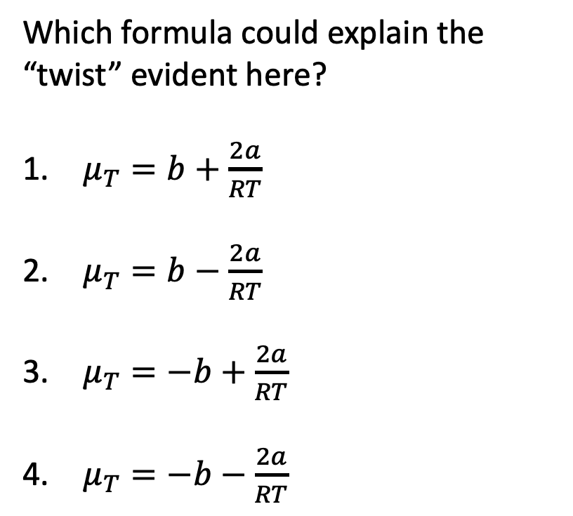
Across weeks – $H(T,P)$ as a thermodynamic surface
$$H$$
Which formula could explain the “twist” evident here?
$μ_{T}=b+\frac{2a}{RT}$
$μ_{T}=b−\frac{2a}{RT}$
$μ_{T}=−b+\frac{2a}{RT}$
$μ_{T}=−b−\frac{2a}{RT}$
P
T
$$dH=C_{P}dT+μ_{T}dP$$

Slide 2
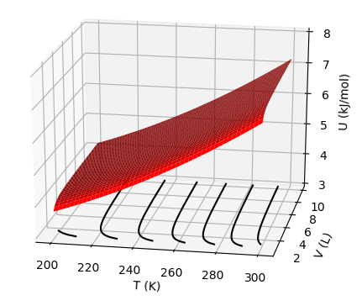
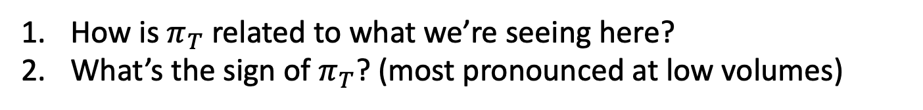
Across weeks – $U(T,V)$ as a thermodynamic surface 1
How is $π_{T}$ related to what we’re seeing here?
What’s the sign of $π_{T}$? (most pronounced at low volumes)

Slide 3

Across weeks – $U(T,V)$ as a thermodynamic surface 2
${\left(\frac{∂U}{∂T}\right)}_{V}$
${\left(\frac{∂T}{∂V}\right)}_{U}$
${\left(\frac{∂U}{∂V}\right)}_{T}$
Which is the correct description of the slopes of these lines?

Slide 4


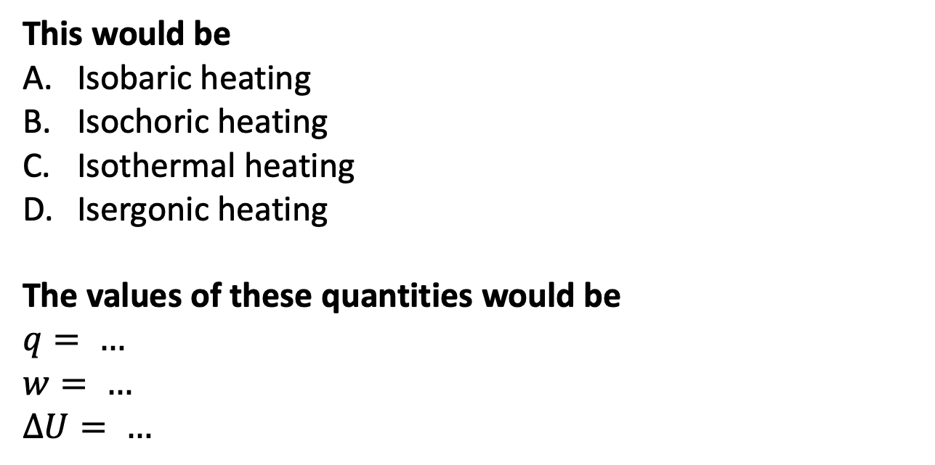
Week 6 - Applying the 1st law
$T_{surr}>T$
$50 J$ of heat go in,
keeping the volume fixed
$$U(T,V)$$
$$T_{surr}$$
V
This would be
Isobaric heating
Isochoric heating
Isothermal heating
Isergonic heating
The values of these quantities would be
$$q= …$$
$w= …$
$∆U= …$
T
T
(system)

Slide 5
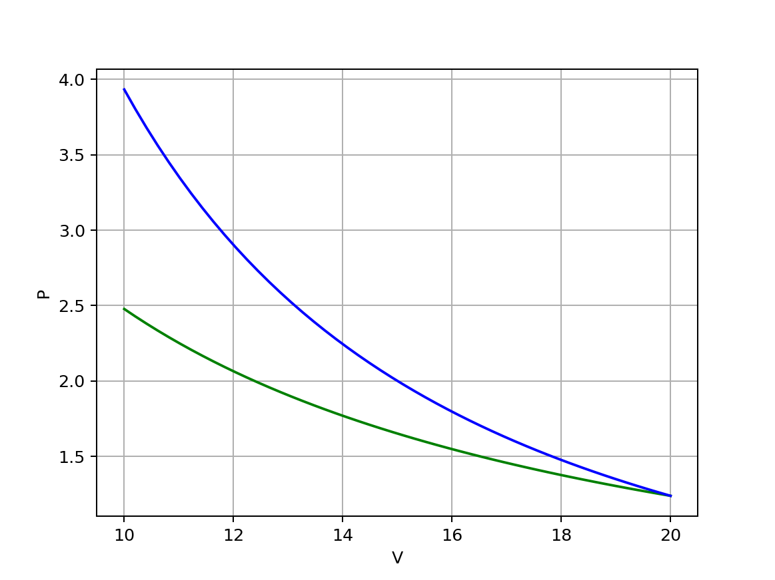
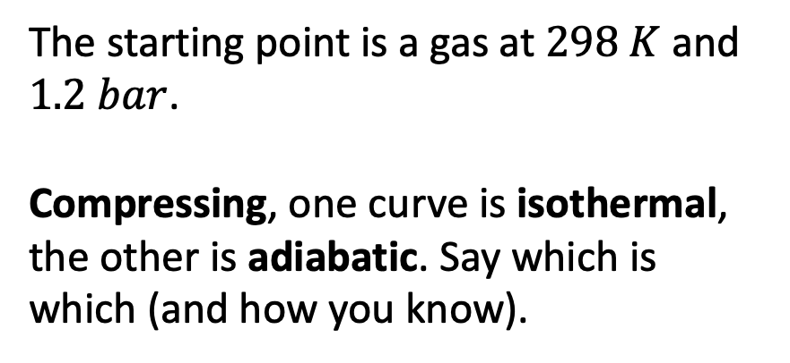
Week 6 – Compressing an ideal gas 1
The starting point is a gas at $298 K$ and $1.2 bar$.
Compressing, one curve is isothermal, the other is adiabatic. Say which is which (and how you know).

Slide 6
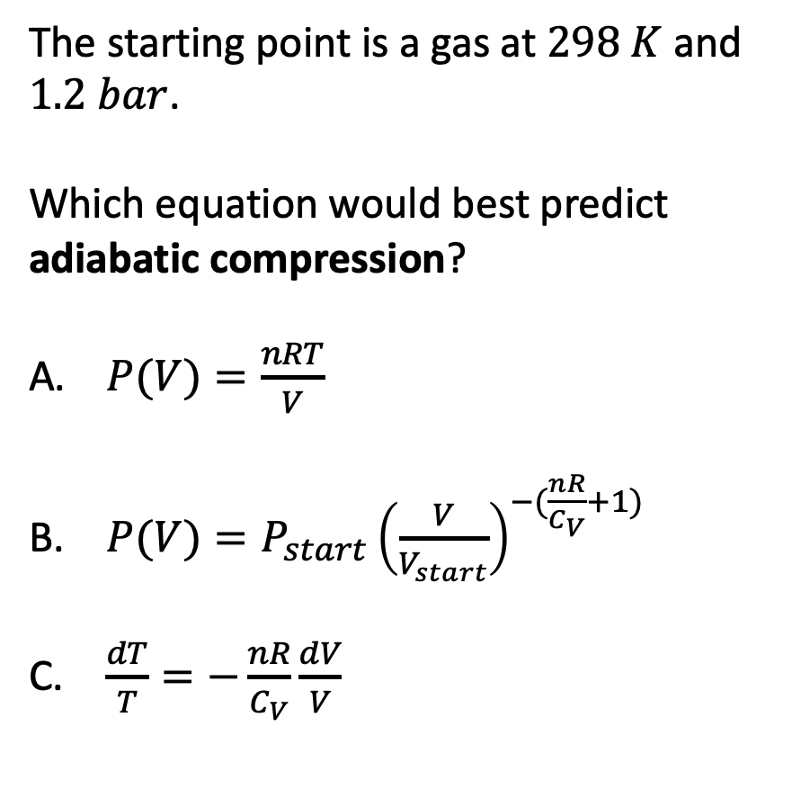
Week 6 – Compressing an ideal gas 2
The starting point is a gas at $298 K$ and $1.2 bar$.
Which equation would best predict adiabatic compression?
$P(V)=\frac{nRT}{V}$
$P(V)=P_{start}{\left(\frac{V}{V_{start}}\right)}^{−(\frac{nR}{C_{V}}+1)}$
$\frac{dT}{T}=−\frac{nR}{C_{V}}\frac{dV}{V}$

Slide 7
Week 6 – Heat engines 1
The efficiency of this heat engine is …
(Need image)

Slide 8
Week 7 – Interpreting thermodynamic surfaces 1
$$H$$
The contours are called
Isentropes
Isochores
Isobars
Isenthalps
Isotherms
P
T

Slide 9
Week 7 – Interpreting thermodynamic surfaces 2
$$H$$
Looks like 240 K is the
Critical temperature
Boyle temperature
Boiling temperature
Inversion temperature
H
P
T

Slide 10
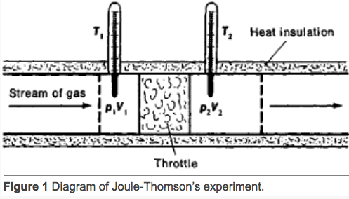
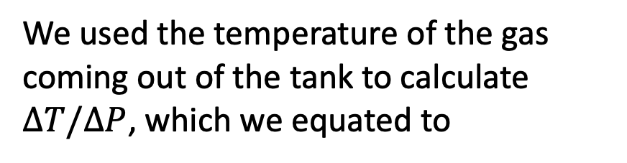
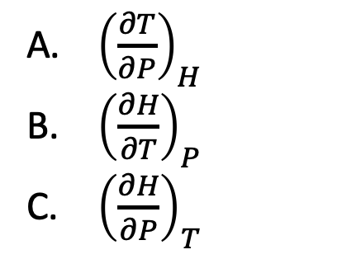
Week 7 – The adiabatic J-T experiment
$$H$$
H
We used the temperature of the gas coming out of the tank to calculate $∆T/∆P$, which we equated to
P
T
${\left(\frac{∂T}{∂P}\right)}_{H}$
${\left(\frac{∂H}{∂T}\right)}_{P}$
${\left(\frac{∂H}{∂P}\right)}_{T}$

Slide 11
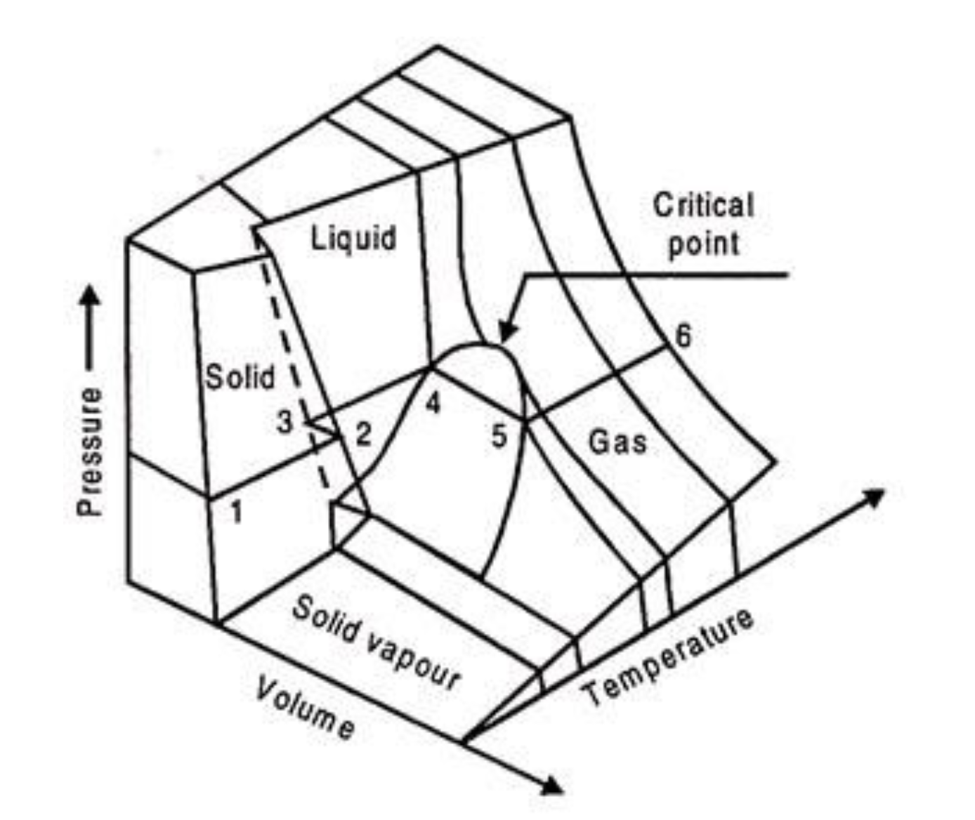
Week 7 – Corresponding states
The process at left corresponds to which curve?
Red
Blue
Orange
Green
gas
gas
liquid
liquid
Isothermal compression

Slide 12
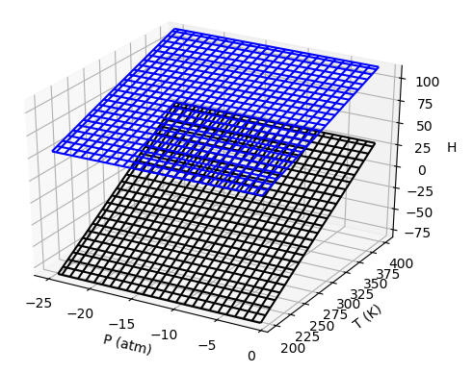
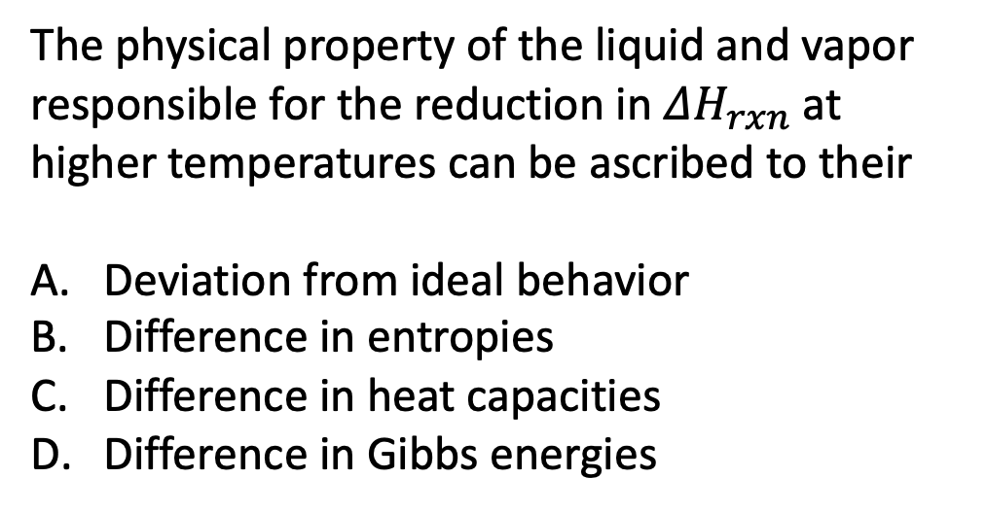
Week 8 - $ΔH_{rxn}$
Upper surface is vapor
The physical property of the liquid and vapor responsible for the reduction in $ΔH_{rxn}$ at higher temperatures can be ascribed to their
Deviation from ideal behavior
Difference in entropies
Difference in heat capacities
Difference in Gibbs energies
Lower surface is liquid

Slide 13




Week 9 – Expansivity and compressibility
$α_{P}≡\frac{1}{V}{\left(\frac{∂V}{∂T}\right)}_{P}$ , $κ_{T}≡−\frac{1}{V}{\left(\frac{∂V}{∂P}\right)}_{T}$
We said that for liquids and solids we can estimate the relative volume change associated with sea level rise due to climate change. Which is the relevant equation for $\frac{∆V}{V}$?
$$∆V$$
$α_{P}∆P$
$α_{P}∆T$
$κ_{T}∆P$
$κ_{T}∆T$
$$V$$

Slide 14

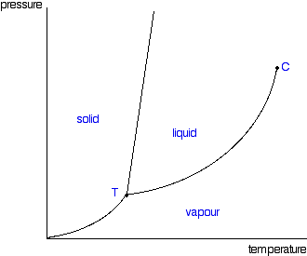
Week 9 – Phase diagrams
P
B (line)
Clapeyron
Clausius-Clapeyron
Raoult
Thomson
Clapeyron
…
…
…
C (line)
D (line)
A (slope)
T

Slide 15
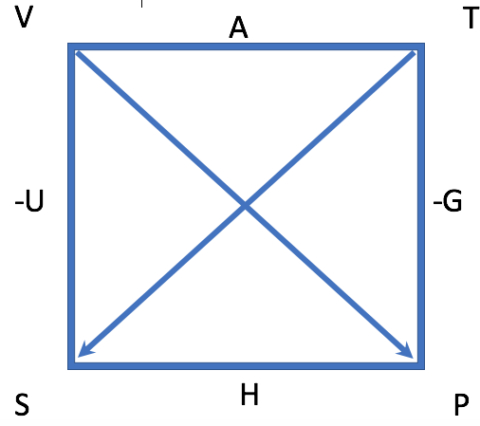
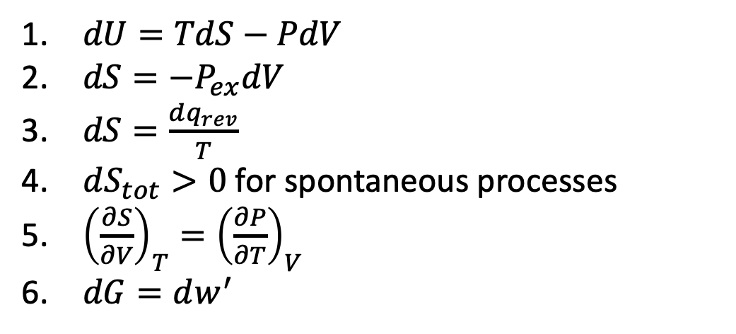
Weeks 10 & 11 – Entropy and the 2nd Law 1
Matching:
The Thermodynamic Definition of Entropy
The 2nd Law of Thermodynamics
One of the four fundamental differential equations of Thermodynamics
A Maxwell relation
$dU=TdS−PdV$
$dS=−P_{ex}dV$
$dS=\frac{dq_{rev}}{T}$
$dS_{tot}>0$ for spontaneous processes
${\left(\frac{∂S}{∂V}\right)}_{T}={\left(\frac{∂P}{∂T}\right)}_{V}$
$dG=dw^{′}$

Slide 16
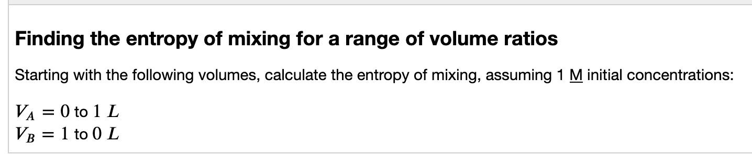
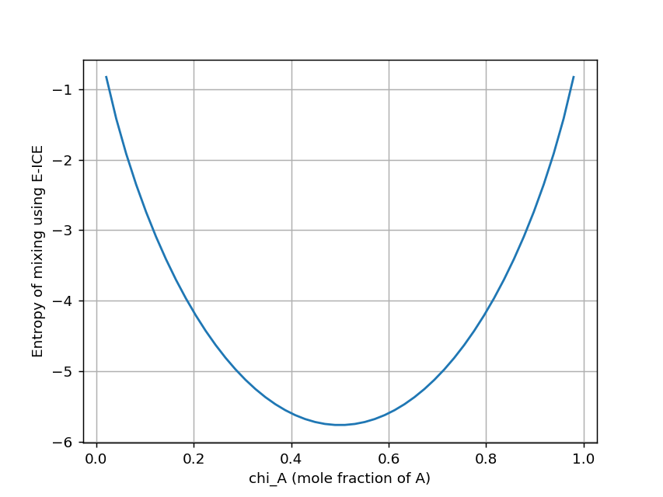
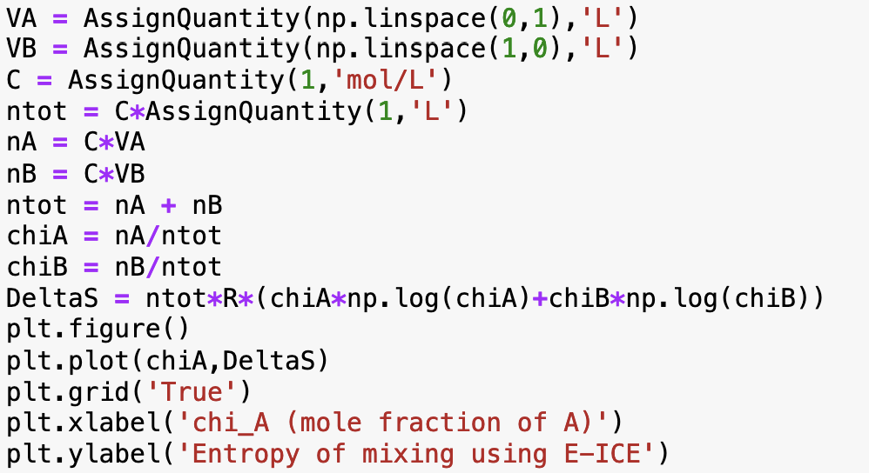
Weeks 10 & 11 – Entropy and the 2nd Law 2
Something is dreadfully wrong here … what?

Slide 17
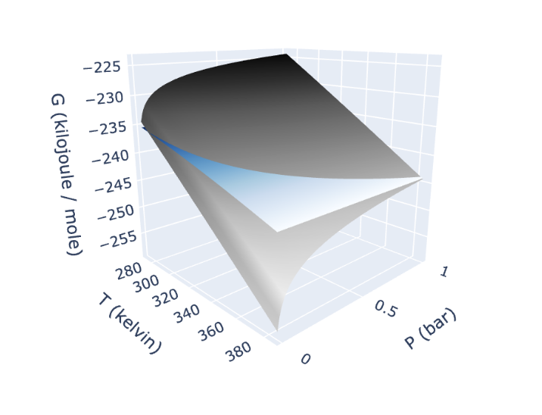

Week 12 – $G(T,P)$ thermodynamic surface
Compared to the liquid surface, how do we know that the gas surface must be
steeper in the pressure direction?
steeper in the temperature direction
Liquid
Gas

Slide 18
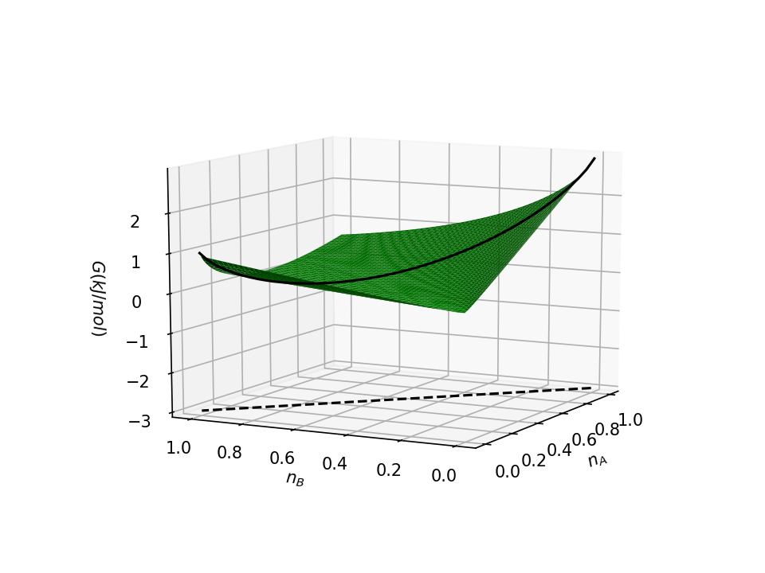
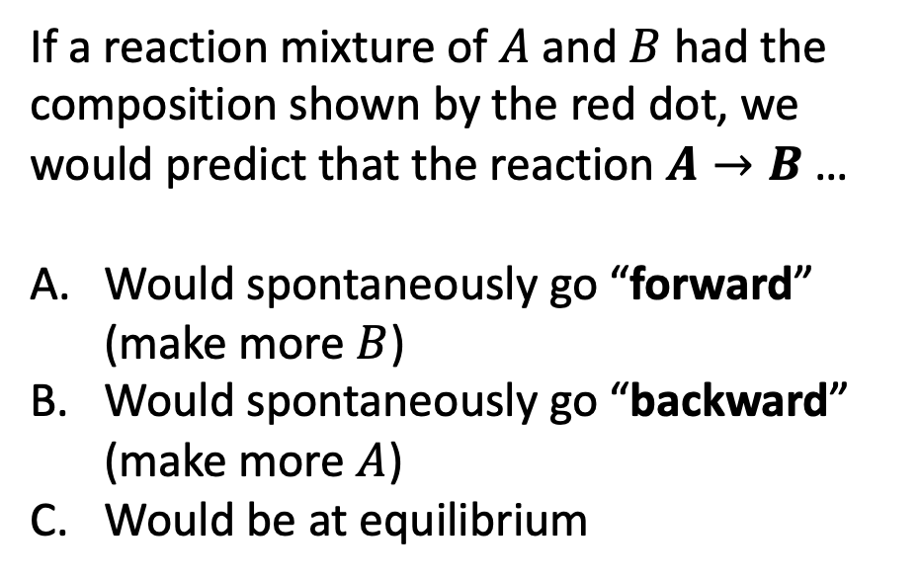
Week 12 – Gibbs energy of reaction
If a reaction mixture of $A$ and $B$ had the composition shown by the red dot, we would predict that the reaction $A→B$ …
Would spontaneously go “forward” (make more $B$)
Would spontaneously go “backward” (make more $A$)
Would be at equilibrium

Slide 19
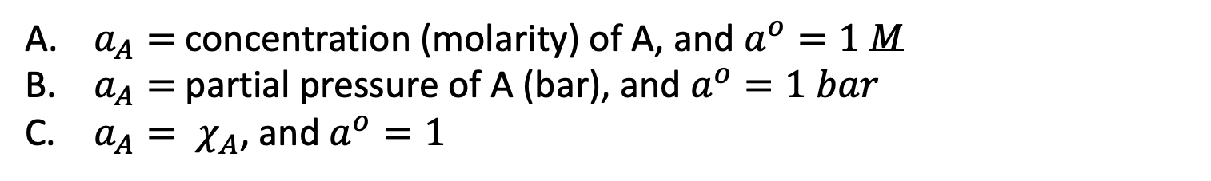

Week 12 – Chemical potentials
$$μ_{A}=μ_{A}^{o}+RT ln\frac{a_{A}}{a^{o}}$$
If A is a solvent, then
$a_{A}=$ concentration (molarity) of A, and $a^{o}=1$ $M$
$a_{A}=$ partial pressure of A (bar), and $a^{o}=1 bar$
$a_{A}= χ_{A}$, and $a^{o}=1$

Slide 20
Week 13 – non-PV work 1
State “X”
The System
State “Y”
Assuming constant T, P, which statement is true?
The Gibbs energy of “X” is greater than that of “Y”
The Gibbs energy of “Y” is greater than that “X”
The Gibbs energy of “X” equals that of “Y”

Slide 21

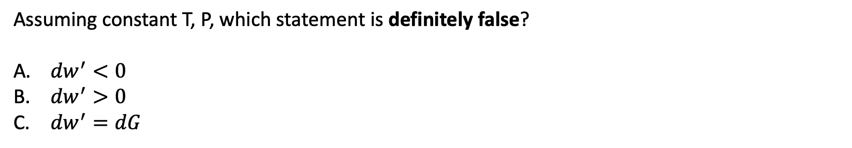
Week 13 – non-PV work 2
State “X”
$${dw}^{′}$$
The System
State “Y”
Assuming constant T, P, which statement is definitely false?
${dw}^{′}<0$
${dw}^{′}>0$
${dw}^{′}=dG$

